Slide 1
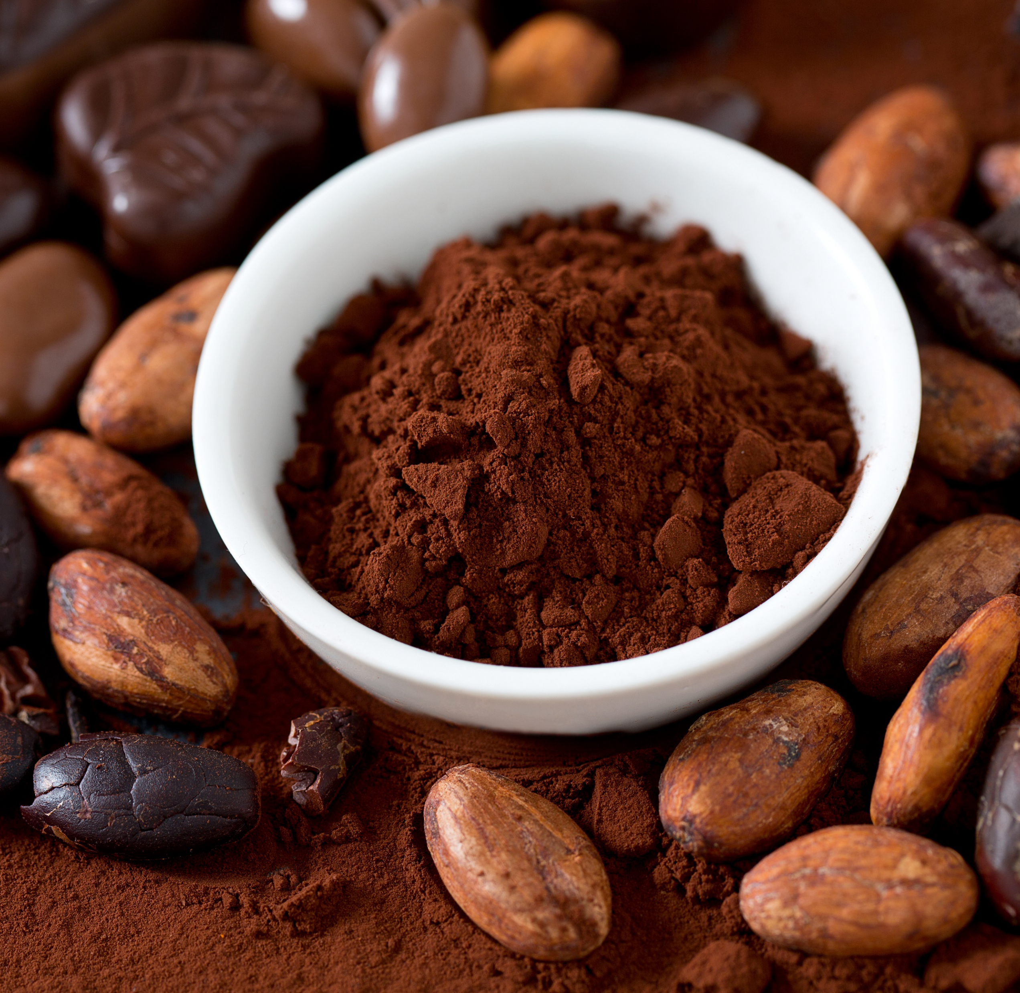
TERM PAPER
COMPUTATIONAL ECONOMICS
Effect of Cocoa Exports on Exchange Rates
By Kodjo Barnor

Slide 2
Introduction
The relationship between the exchange rate and agricultural exports, particularly cocoa exports, is examined in this study in order to gain a better understanding of the key causes of exchange rate volatility and the channels through which they manifest.
Since currency deregulation in 1986, Ghana's economy has been hampered by repeated depreciation of the Cedi, necessitating currency redenomination in 2007.

Slide 3
Problem Statement
In Ghana, the Financial Sector Adjustment Programme (FINSAP), which was a component of the Economic Recovery Program (ERP), launched significant changes to the financial sector in the 1980s, including the abandoning of fixed exchange rates in favor of a free-floating regime[1].
This transition was made on the assumption, among other things, that flexible exchange rates would alleviate the boom-bust cycle and steer the country toward a growth path, with the growth-enhancing effect of exchange rate pass-through on consumer prices, terms of trade, trade volumes, and investment.
As Ghana adopted a free exchange rate regime in the 1980s, the Ghana Cedi has depreciated against major currencies, most notably the US Dollar (US$), albeit not uniformly, since the Ghana Cedi saw some stability between 2002 and 2007[1]. Ghana's currency was redenominated on July 1, 2007, and one dollar was swapped for 93 pesewas.
As a result of this action, the Cedi depreciated, and by the end of July 2009, the US dollar was worth GH1.49. Recently, the Cedi has been exceedingly volatile, dropping to 6.0 Ghana Cedis in 2021. This has been a source of concern for some time, as it has been asserted that it adds to the increase in consumer price inflation. As can be seen from the graph, the period following 2007 saw a dramatic increase in comparison to the preceding period.

Slide 4
Problem Statement
The debates over the exchange rate and exports have centered on the effect of currency depreciation on exports; in this situation, there is an incentive to export because the exporter obtains a higher proportion of its local currency for the same exports[2,3,4]. Additionally, a stronger currency is thought to make exports from that nation more expensive, resulting in a decrease in exports, as Schuh argues in his seminal study on the Exchange Rate and US Agriculture [2]. According to some research conducted in Ghana, a considerable positive relationship exists between current cocoa export prices and production, and increases in cocoa export prices as a result of exchange rates encourage farmers to boost production[5].
Cocoa is the bedrock of Ghana's formal economy, accounting for a significant share of the country's total export profits and revenue[6]. Cocoa was initially exported around the turn of the twentieth century, and Ghana was the world's largest exporter from 1911 and 1976, accounting for 30-40% of global production. Ghana is currently the world's second largest producer of cocoa beans, after Ivory Coast, accounting for around 20% of global output. Around 80% of the country's cocoa is shipped raw, with the remaining 20% processed (cocoa butter, cocoa paste, and cocoa shells). Ghana's cocoa is primarily exported to the United States, the European Union, and Asia (raw and processed). As is the case in the majority of cocoa-producing countries, Ghanaian cocoa is grown by smallholder farmers. Cocoa export sales have steadily declined from 67 percent in 1986 to around 19.1 percent in 2020, with a $2.3 billion value.

Slide 5
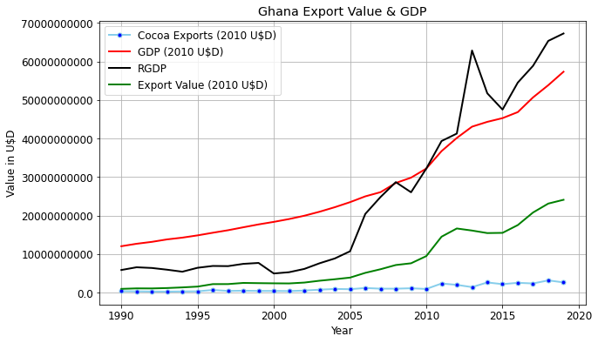
Problem Statement

Slide 6
Methods: Data
Annual data on cocoa exports from Ghana between 2000 to 2020 will be obtained from the International Trade Center's trade statistics. Annual cedi exchange rate with the dollar which is the major trading currency between 2000 to 2020 will also be obtained from data from the World Bank's development indictors. Other indicators such as GDP per capita will be obtained from the same source
Directed Acyclic Graphs
A directed acyclic graph (DAG) is a visual representation of a graph that includes directed edges (arrows), linking nodes (variables), and their pathways. To uncover these causal linkages, computer algorithms construct graphs including nodes (vertices, variables) and edges between nodes.

Slide 7
Granger Causality
Granger [31] causality tests are frequently used to determine causal links between many time series. Additionally, these tests can be used to determine the endogeneity of particular variables in a system. This is accomplished by determining if the lags of one variable are beneficial for explaining another variable. Thus, two regressions are computed while performing a Granger causality test. We regress Y against lagged values of Y and X to obtain our unrestricted regression. In restricted regression, we compare Y to only its lagged values. The F-test is then used to determine if the group of coefficients associated with the lagged values of X is substantially different from zero. If they are substantial, we can rule out the hypothesis that X does not affect Y, as historical levels of X contribute to the explanation of the current level of Y. When the lags of one variable aid in the explanation of another, we might assert that X Granger causes Y. If the results reveal that X Granger causes Y and Y Granger causes X, then one or more variables are likely to cause X and Y, indicating that they are endogenous variables in the system.
Measurements a-priori expectation
Cocoa Exports U$D Positive
Exchange Rates % Positive
GDP U$D Positive
Total Exports U$D Positive

Slide 8
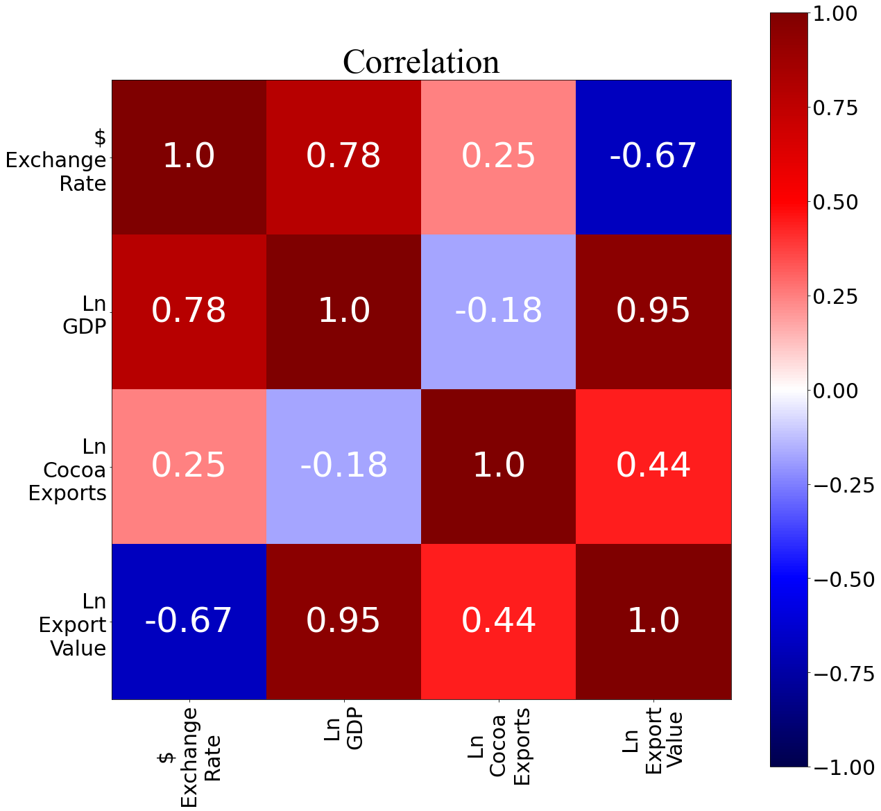
Results

Slide 9
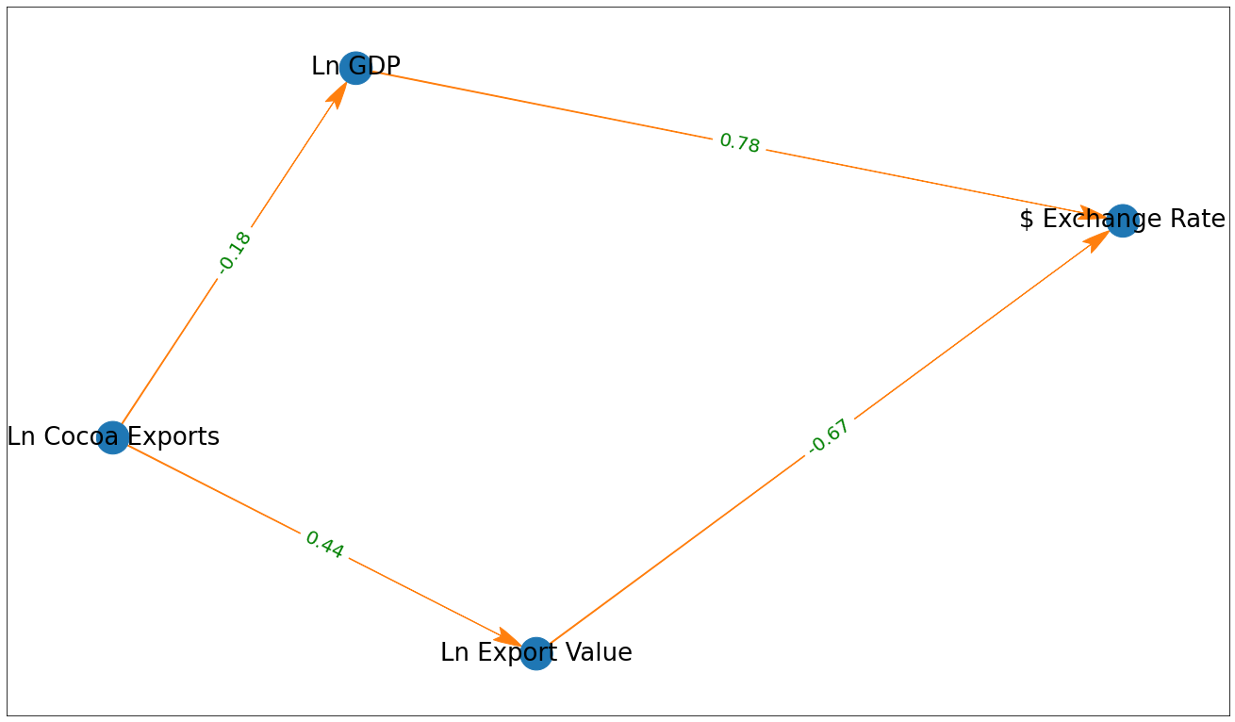
Results

Slide 10
Results
$ Exchange Rate_x Ln GDP_x Ln Cocoa Exports_x Ln Export Value_x
$ Exchange Rate_y 1.0000 0.0002 0.0022 0.0004
Ln GDP_y. 0.0052 1.0000 0.7364 0.0384
Ln Cocoa Exports_y 0.1289 0.0000 1.0000 0.0000
Ln Export Value_y 0.3768 0.1670 0.0800 1.0000

Slide 11
Technical Efficiency Results
Input
Extension | 0.00261 *** (.00096)
Age | 0.01336*** (0.00191)
Agesq | -0.00013 *** (.00002)
Occupation | 0.07936*** (0.03085)
Agrochemical | 0.00417 * (0.00248)
Experience | 0.00143 * (0.00084)
Credit | 0.01391 (0.02305)
Constant | 0.71647
Fstat | 0.0000
Adjusted R-squared | 0.1713
N | 390

Slide 12
Results
From the results, extension, age, age-squared, occupation, agrochemical and experience were statistically significant at various levels of significance.
Except of age-squared, the rest of the significant variables had a positive impact on technical efficiency

Slide 13
CONCLUSION
As a result of the study, policy makers should focus on farmers' training and extension programs to increase technical efficiency on farms.
Older farmers should be targeted to accept new technologies than young farmers.
Young farmers should be encouraged to farm to gain experience as experience was found to have an effect on technical efficiency.
Fulltime farmers were more efficient hence incentives should be provided to promote farming as a fulltime occupation.

